Slide 1
Short Course in Linguistics
Intro to Phonetics

Slide 2
Aims
Introduction to some of the core principles of:
Linguistics
Computational Linguistics

Slide 3
Topics
Phonetics and Phonology
Morphology
Syntax
Semantics
Identity

Slide 4
Some recurring themes...
Languages are extremely diverse
Over 7000 languages worldwide
No person ever has full mastery of the language they use
Most people in the world speak more than one language
43% bilingual
13% trilingual
3% quadrilingual
1% are polyglots...

Slide 5
What is language?
Complex, mutually agreed system for linking form to meaning
Arbitrary
Universal amongst humans
Hierarchical
Constantly changing

Slide 6
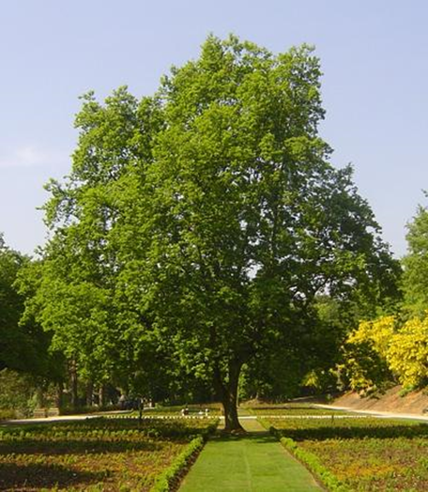
Arbitrariness of Language
árbol
شجرة
shū
Дерево
yugu
Baum
lignum
ağaç

Slide 7
Onto today’s topic...

Slide 8
Phonetics and Phonology
Phonetics
‘the study and classification of speech sounds’
Phonology
‘the study of relationships among the speech sounds of a language’

Slide 9
How do we produce speech sounds?
Majority of speech sound created by releasing air from the lungs through the mouth or nose
We use the stream of air, vocal chords and different configurations of the mouth
Two different types of sounds
Consonants – use the mouth to restrict the flow of air
Vowels – allow free flowing

Slide 10
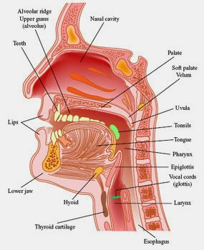
The vocal tract

Slide 11
Segue
For the rest of this hour, you need to suspend any notion you have that you may know how to spell
We’ll be spelling things exactly as they sound, using the International Phonetic Alphabet (IPA)
Hopefully you all have an IPA sheet to read from...

Slide 12
Consonants
Consonants are characterised in two ways:
Place of articulation – where we impede the flow of air
Was the air stopped by you teeth?
Did you make a sound by closing your pharynx?
Manner of articulation – the way in which we impede the flow of air
Did you use your vocal chords?
Did you roll the sides of your tongue?
Did you stop the air completely? Or let it through, hissing?

Slide 13
The vocal tract

Slide 14
Consonants
Consonants can be formed in two ways
Air going out of the mouth (egressive)
Air being pulled into the mouth (ingressive)
The IPA sheet shows the full range of consonants that can be made in the human vocal tract.
There are clicks and ejectives as well, but we’ll leave those for another day, they can be treated in the same way as all other consonants

Slide 15
Vowels
Vowels are made by engaging your vocal chords and shaping your vocal tract
Only a few ways to alter the sound of a vowel
Height of your tongue
‘Backness’ of your tongue
Modifying the way your vocal chords vibrate

Slide 16
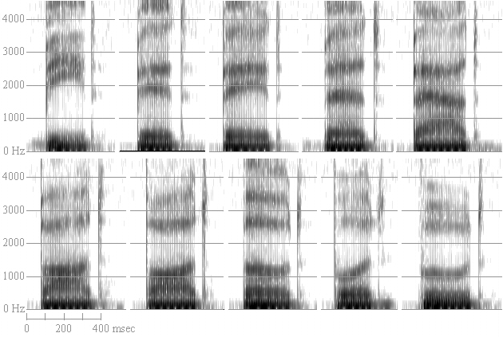
Reading a specrtogram
https://home.cc.umanitoba.ca/~robh/howto.html#
Notes:
Figure 3. Wide band spectrograms of the vowels of American English in a /b__d/ context. Top row, left to right: [i, ɪ, eɪ, ɛ, æ]. Bottom row, left to right: [ɑ, ɔ, o, ʊ, u].

